Slide 1
Advanced Systems Analysis and Design Use Case Analysis SOFT 30121 L5

Slide 2
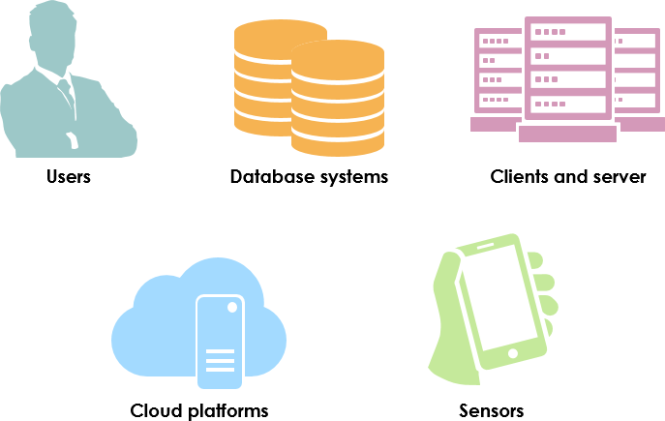
Use Case Analysis
RecoSystems Analysis and Design
Alan Dennis; Barbara Haley Wixom; Roberta M. Roth
2019
Chapter 4

Slide 3
Use Case Analysis
Objectives of Lecture 7
Explain the purpose of use cases in the analysis phase of the SDLC.
Describe the various parts of a use case and the purpose of each part.
Describe how use cases contribute to the functional requirements.
Describe how use cases inform the development of test plans.
Explain the process used to create a use case.
SOURCE: RecoSystems Analysis and Design
Alan Dennis; Barbara Haley Wixom; Roberta M. Roth
2019
Chapter 4

Slide 4
Use Cases
A key aspects of determining the requirements is understanding the user requirements.
Use cases are a means of expressing user requirements
Use cases represent how a system interacts with its environment by illustrating the activities performed by the users and the systems responses.
Especially valuable for systems that commonly involve extensive user interactions (websites/mobile app etc.)

Slide 5
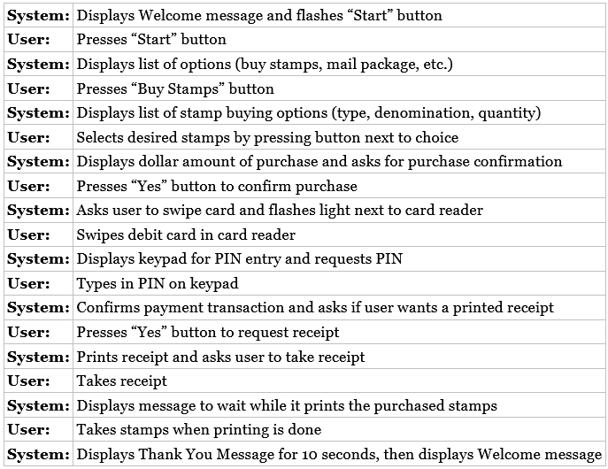
In a nutshell
Each use case describes how an event triggers actions performed by the system and the user.
A user-system dialog is shown here. This tells a lot about what the user does while working with the system.
From this, we can describe more functional requirements, without needing to know anything that’s going on behind the scenes.

Slide 6
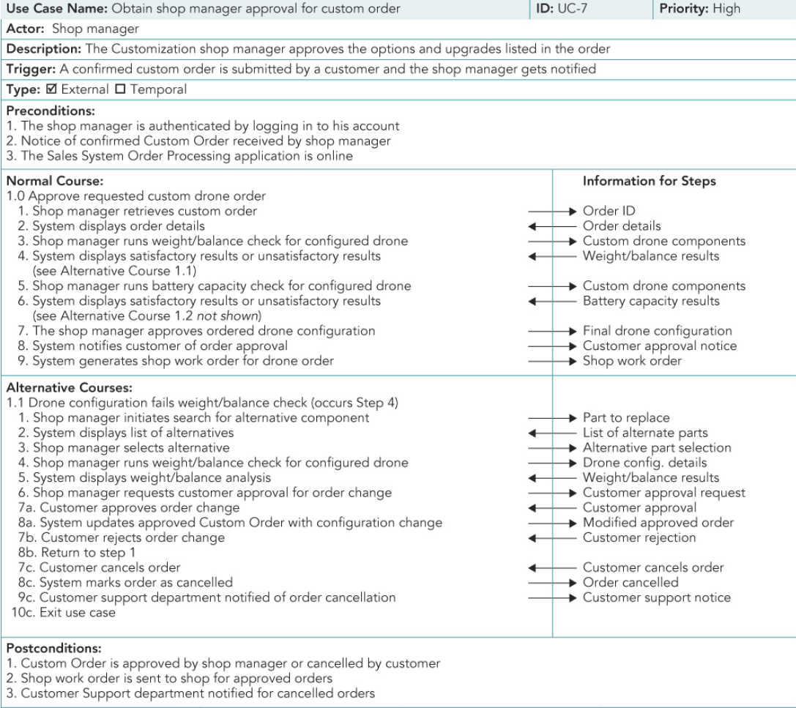
Use case format

Slide 7
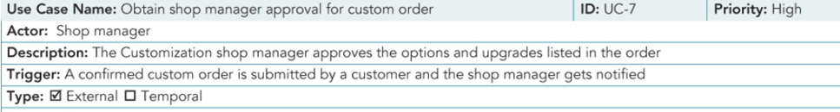
Basic information
Name and number: Should be simple yet descriptive
Description: What is this use case’s purpose?
Priority: Relative significance of the use case in the overall system. Earlier versions of the system might target the essential systems first.
Actor: Refers to a person, external software system or sometimes a hardware device.
Trigger: The event that causes the use case to begin. Could be an external or temporal trigger (such as a book being overdue etc.)

Slide 8
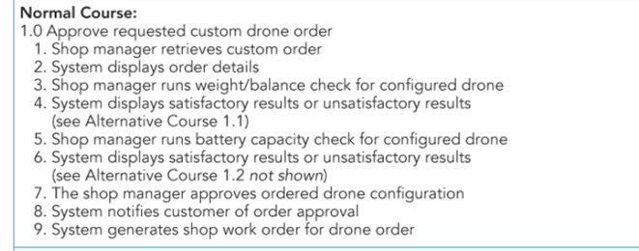
Preconditions: Define the state the system must be in before the use case commences.
Normal Course: Sometimes called the “happy path”, because no problems should arise when the steps are followed normally.

Slide 9
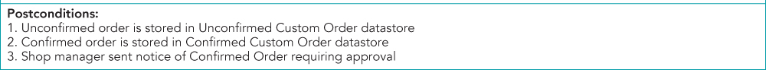
Alternative course: Depict branches in logic that also will lead to a successful conclusion of the use case.
Postconditions: What state is everything in after the use case is complete? Often also serves as the preconditions for the next use case.

Slide 10
Practical tips
Iterate on your use cases! You probably won’t get them exactly right first time
Don’t get too caught up in figuring out the right level of detail. Your focus should be describing the user’s objectives in working with the system
Very simple processes that are well explained in the requirements definition might not need a use case.

Slide 11
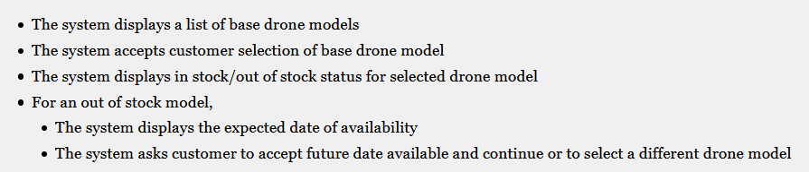
Use cases and functional requirements
As we said earlier, use cases are a helpful tool to use to understand user requirements
At the same time, use cases don’t tell the whole story since they omit a lot of detail, and only convey the user’s point of view

Slide 12
Creating use cases
As with requirements gathering, the most common ways to gather information about use cases is through using the techniques discussed in the last chapter.
The following 4 step process can also be used:

Slide 13
1. Identify the use cases
Activities: Start a use case report form for each use case by filling in the name, description and trigger. If there are more than nine use cases, group them into packages.
Typical questions asked:
Ask who, what, when, and where about the use cases (or tasks).
What are the major tasks that are performed?
What triggers this task? What tells you to perform this task?

Slide 14
2. Identify the major steps within each use case
Activities: For each use case, fill in the major steps needed to complete the task.
Typical questions asked:
Ask how about each use case.
What information/forms/reports do you need to perform this task?
Who gives you these information/forms/reports?
What information/forms/report does this produce and where do they go?
How do you produce this report?
How do you change the information on the report?
How do you process forms?
What tools do you use to do this step (e.g., paper, e‐mail, phone)?

Slide 15
3. Identify elements within steps
Activities: For each step, identify its triggers and its inputs and outputs
Typical questions asked:
Ask how about each step.
How does the person know when to perform this step?
What forms/reports/data does this step produce?
What forms/reports/data does this step need?
What happens when this form/report/data is not available?

Slide 16
4. Confirm the use case
Activities: For each use case, validate that it is correct and complete.
Typical questions asked:
Ask the user to execute the process, using the written steps in the use case—that is, have the user role‐play the use case.

Slide 17
Back to your functional requirements
Hopefully you now understand how use cases can be used to better understand the system
You can now go back to your functional requirements and add more detail where necessary. This will hopefully add more detail which will be helpful to the members of the development team

Slide 18
Next Lecture
Process Modeling

